Slide 1
Predicting the Stock Market
Modeling 30 Years of S&P 500 Trading
Aria Algamehand, Alec Anderson, Reed Oken
University of San Diego, MS Applied Artificial Intelligence
AAI 501: Introduction to Artificial Intelligence
Video presentation: https://youtu.be/I0vB-F7O164
Github repo: https://github.com/okenreed/aai501_final

Slide 2
Introduction
The stock market is a key indicator of economic stability and a source of investment opportunities.
Accurately predicting future trends in the stock market is a challenging and complex task that requires extensive data analysis and the use of advanced machine learning algorithms.
The project goal is to analyze 30 years of S&P 500 stock data to build a system that can make accurate predictions about future trends in the market.
The project will utilize a variety of machine learning algorithms such as regression, time series analysis, and deep learning to train models on historical data and predict future market trends.

Slide 3
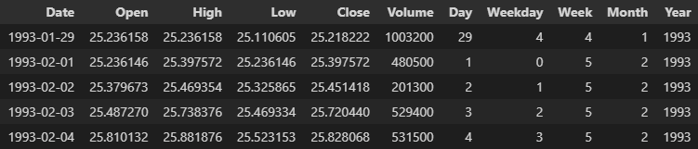
Data cleaning and preparation
Data is historically well maintained
Available on multiple platforms, Kaggle, Yahoo Finance
No null/NaN values
Date column was an object rather than a date string
Notes:
Each day of trading data includes date, daily trading prices (open, close, high, low), daily trading volume, and the date split into individual columns; year, month, day of month, week of the year, and day of the week

Slide 4
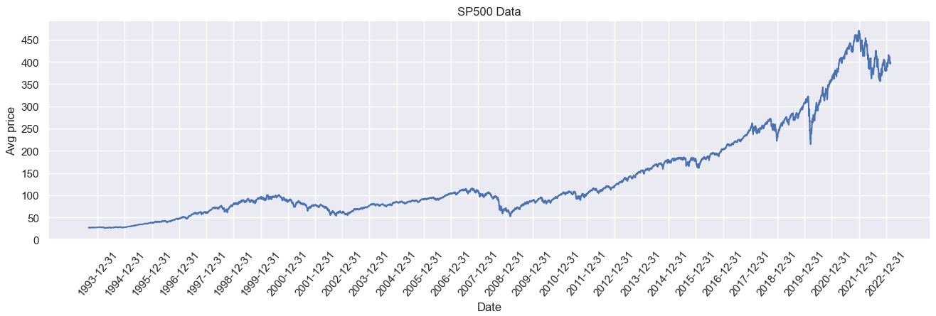
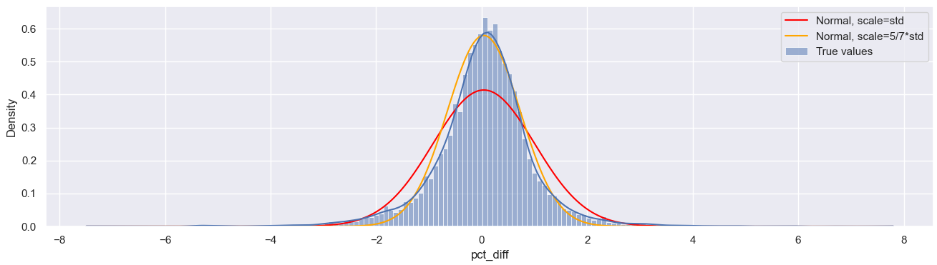
Exploratory data analysis
Focused on feature extraction
Including technical indicators in dataset
Worked to identify a target feature

Slide 5

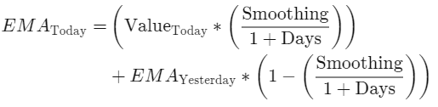
Technical indicators
Relative strength index (RSI)
Momentum oscillator bounded from 0 to 100 over a time interval
Exponential moving averages
Moving average with greater weight on most recent data points
Exponential moving average with fixed timeframe (EMAF)
Exponential moving average with adaptive multiplier (EMAM)
Weighting adjusted based on asset volatility
Exponential moving average with support and resistance (EMAS)
Accounts for support and resistance levels
Notes:
Moving averages smooth out price fluctuations and provide a better view of underlying price trends for an asset.
EMAM - weighting adjusted based on volatility. Periods of high volatility have greater weight than periods of low volatility
EMAS - accounts for support levels (where traders are likely to enter the market, offering support to the stocks price), and resistance levels (where traders are likely to exit the market, offering resistance to the stock exceeding this price)

Slide 6

Identifying a target feature
Average price for the next day
Average price calculated by averaging the high and low prices
Next day average was then shifted by one day in the dataframe
Does not account for inflation or general market trend
Daily percent change
Price difference between one day and the next, as a percentage of the first day
Accounts for general market trend and inflation
Both features were considered as prospective features during modeling

Slide 7



Model selection and analysis
Long short term memory (LSTM), linear regression, support vector machine (SVM), decision tree, gradient boosting, and random forest
Models chosen are generally unable to account for external factors
General economic indicators, geopolitical events, overall market sentiment
These factors are not part of the dataset being used
Model performance judged using performance metrics
Mean squared error (MSE)
Mean absolute error (MAE)
Root mean squared error/deviation (RMSE)

Slide 8
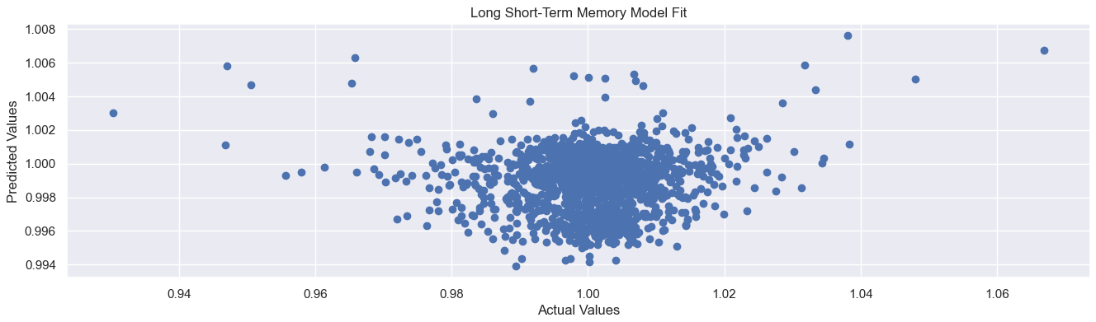
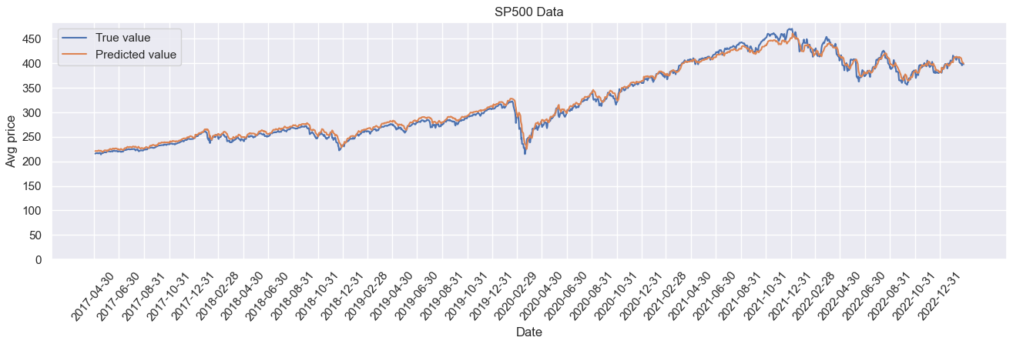
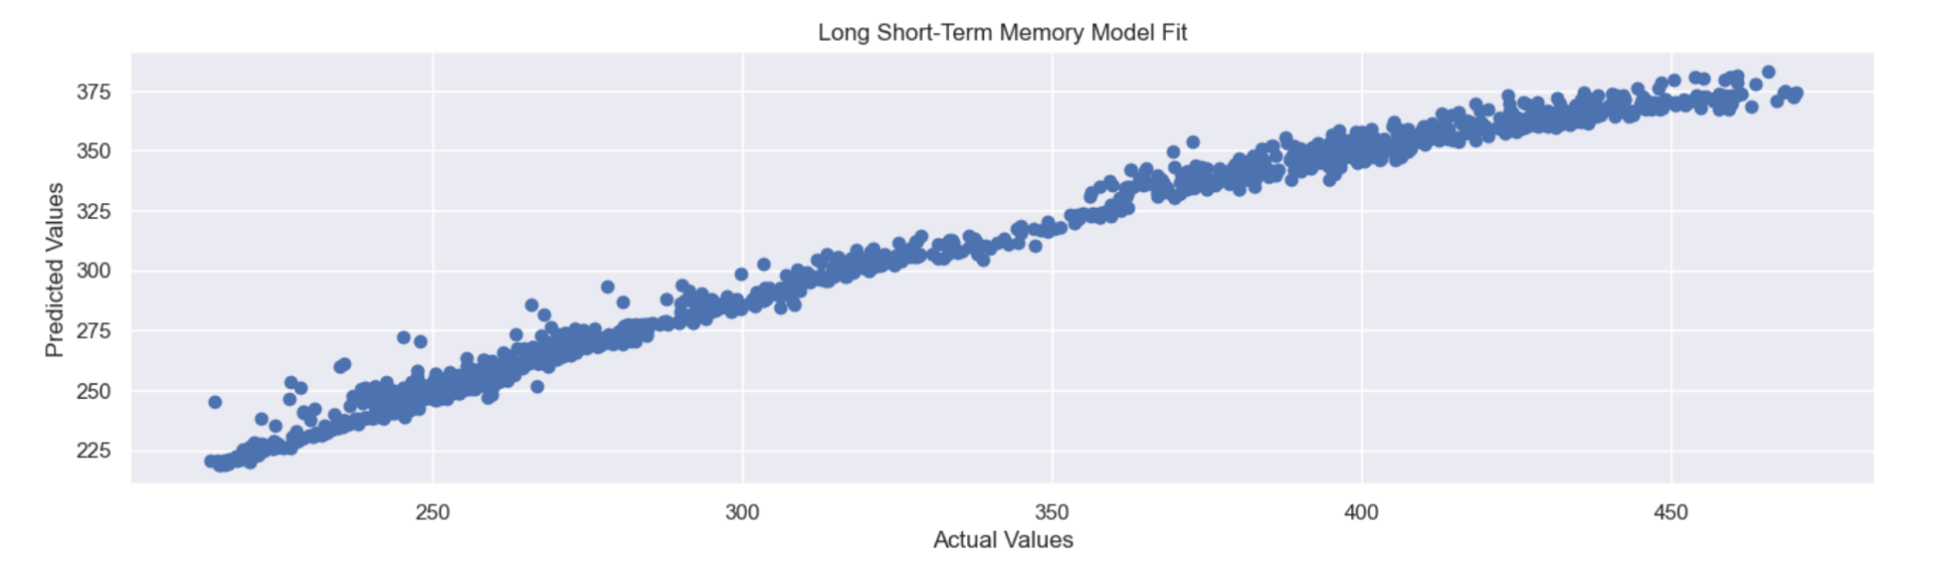
Long short term memory
(LSTM)
Simple single layer LSTM with 64 nodes
20% dropout layer
58.72 MSE, 6.09 MAE, 7.66 RMSE
Percentage modeling
Price modeling

Slide 9
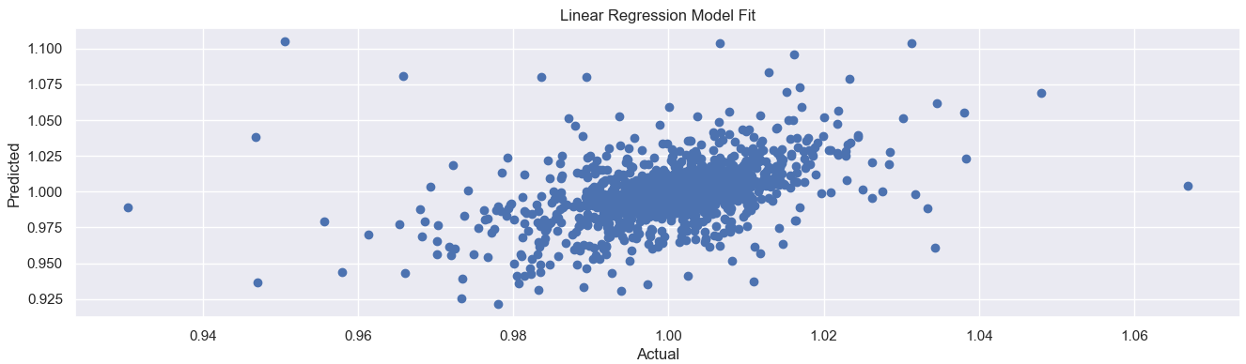
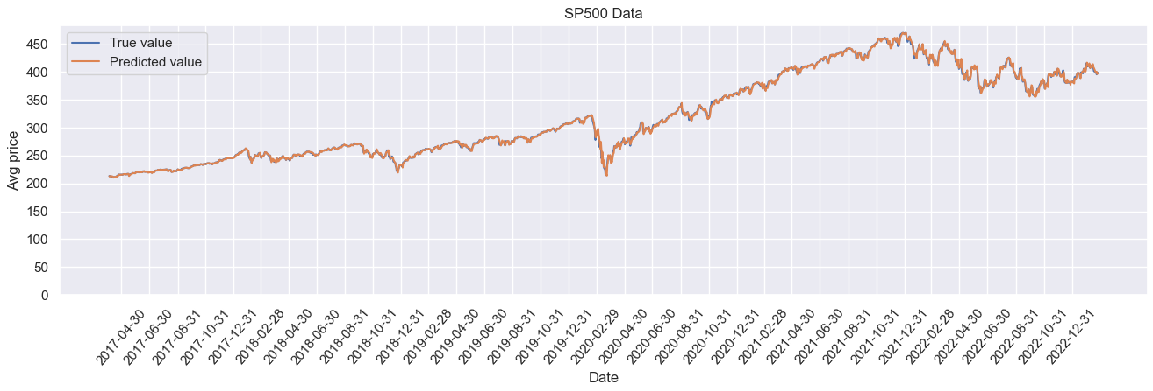
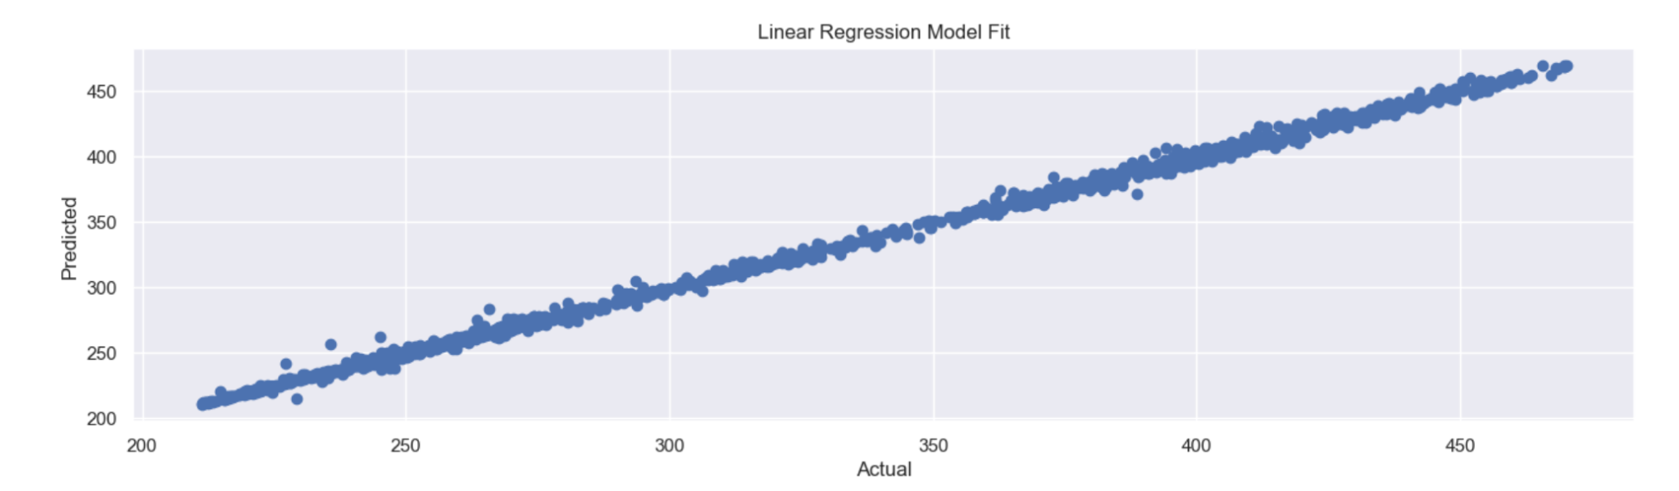
Linear regression
Much better performance predicting target price over percentage
Highly accurate, with R2 score of .99
7.87 MSE, 1.85 MAE, 2.80 RMSE
Percentage modeling
Price modeling

Slide 10
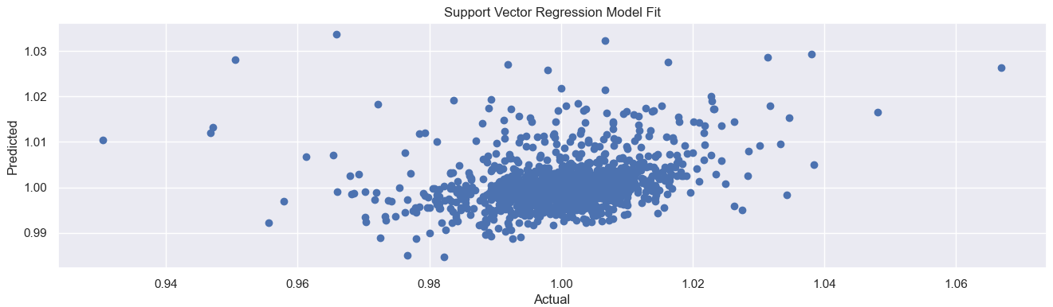
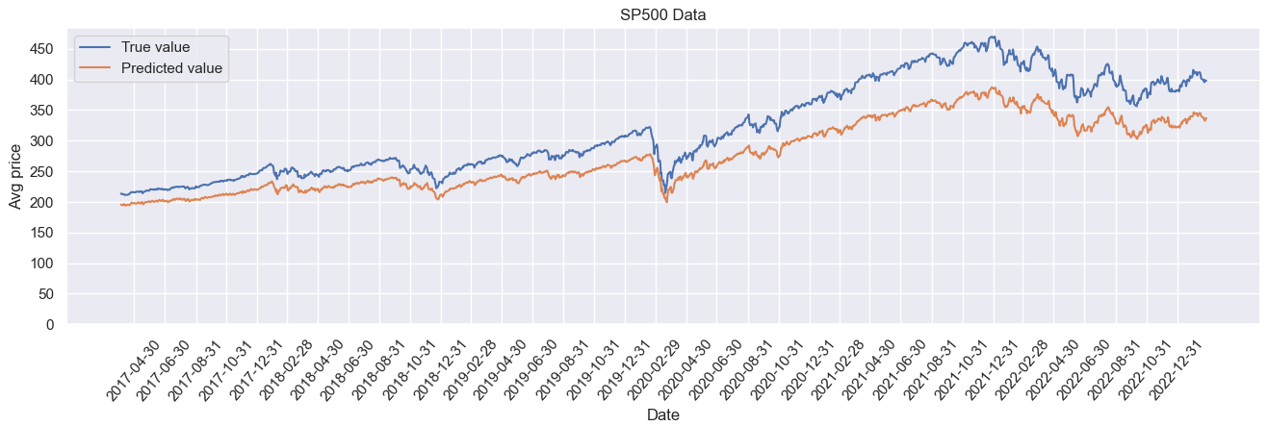
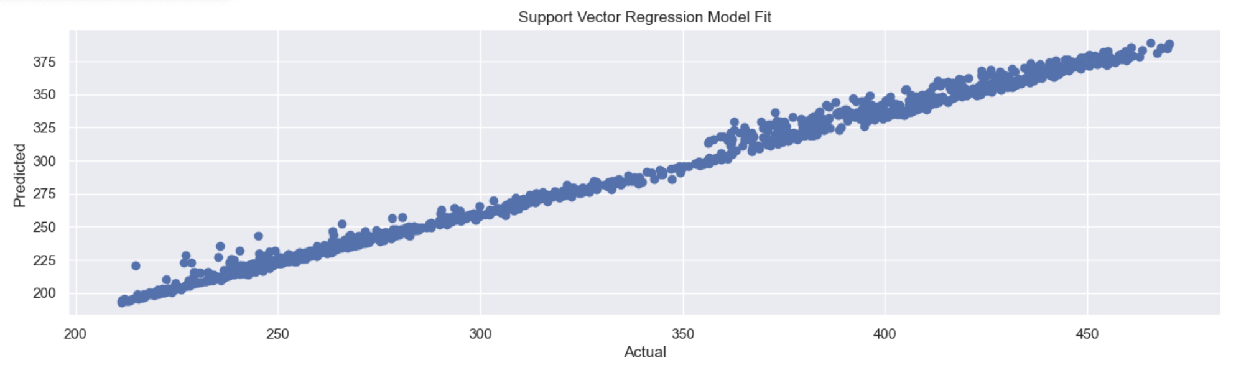
Support vector machine (SVM)
Much better performance predicting target price over percentage
Consistently underestimates market performance
2345.79 MSE, 44.34 MAE, 48.43 RMSE
Percentage modeling
Price modeling

Slide 11
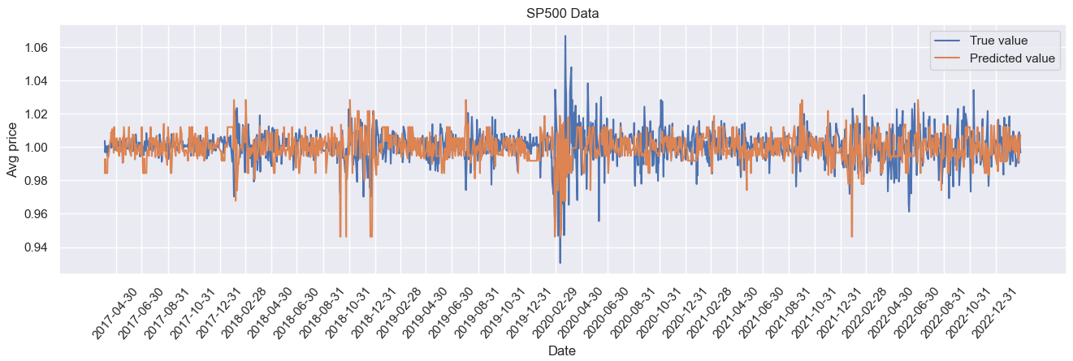
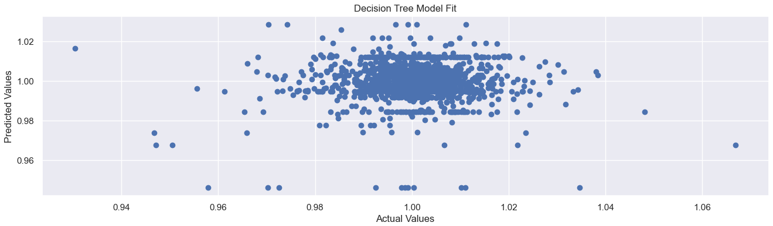
Decision tree
Did not fit well when target feature was price
Much better fit for target feature of percent change
Performance scores are not comparable across different target features
Percentage modeling

Slide 12
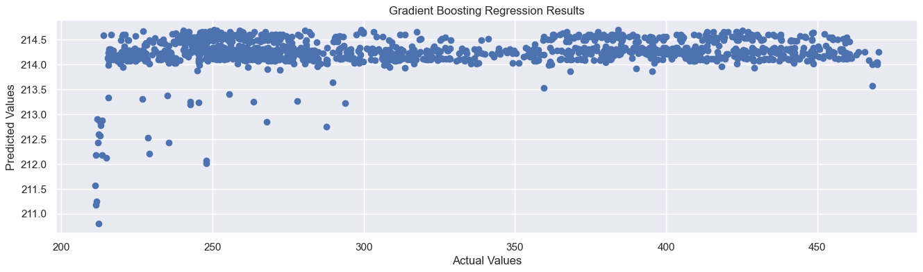
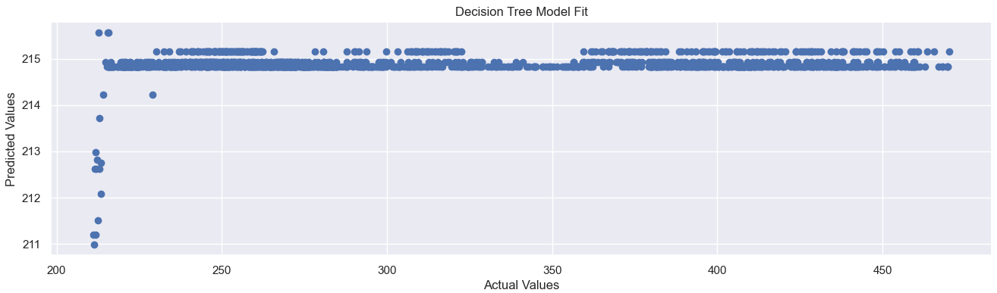
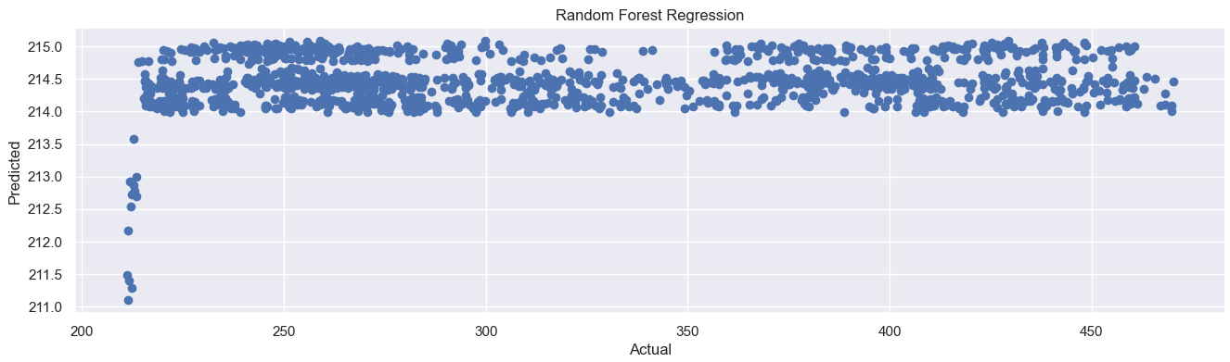
Other models
Decision tree, gradient boosting, random forest
Generally did not fit the data well for price target
Predicted all target scores within a ~5 value range
16000+ MSE, 100+ MAE, 125+ RMSE
Price modeling

Slide 13
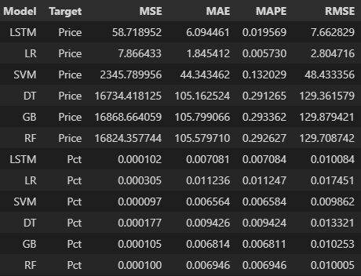
Conclusion
Linear regression performed the best
MSE: 7.87
MAE: 1.85
RMSE: 2.80
LSTM performed reasonably well for basic implementation
SVM consistently underestimated market performance
Tracked market movements relatively well otherwise
Decision tree, gradient boosting and random forest regression models were included for comparison purposes, but performed poorly

Slide 14
Recommendations
Alternative data sources such as news and social media could be added to include market sentiment to our models. The addition of market sentiment can provide insights to why the S&P 500 increased or deceased in a given time period.
Hybrid models could be implemented as an addition to linear regression. Example: creating a hybrid model that appends linear regression + support vector or linear regression + decision tree to increase the accuracy of our models.
Scaling techniques such as standardization or normalization can be used to ensure the model is not biased towards features with a higher range of values.
Cross-validation techniques such as K-fold cross-validation should be used to test the model on different sets of data to help identify whether the model is generalizing well and assist in selecting the best hyperparameters.

Slide 15
Data source
Kaggle:
https://www.kaggle.com/datasets/gkitchen/s-and-p-500-spy?resource=download

